Slide 1


Insights in Consumer Goods Domain
Presented by-
Ankur Katiyar

Slide 2
Problem Statement AtliQ Hardwares is one of the leading computer hardware producers in India and has expanded well in other countries too. However, the management noticed that they do not get enough insights to make quick and smart data-informed decisions.

Slide 3
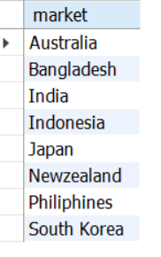
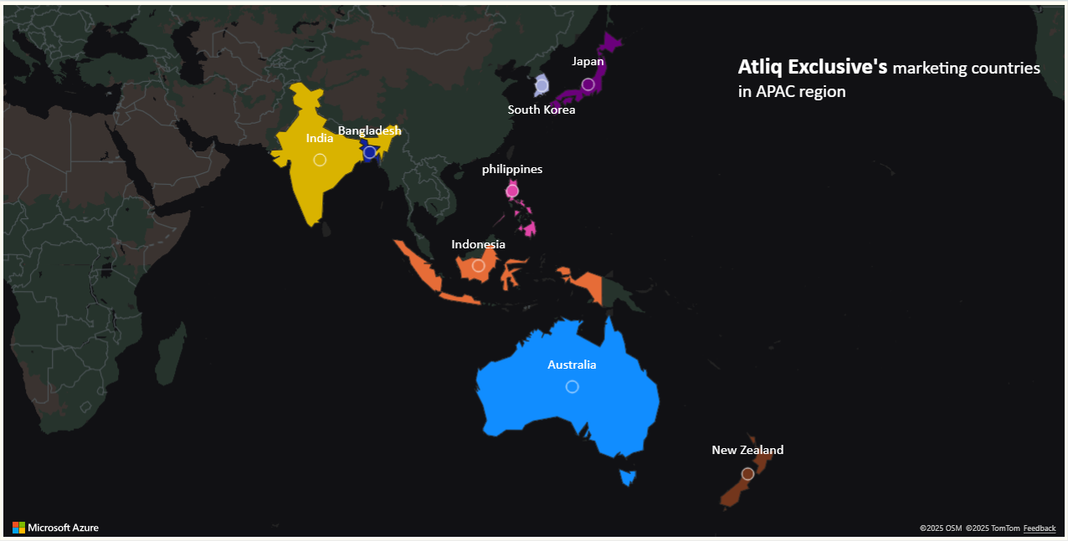
Q1. Provide the list of markets in which customer "Atliq Exclusive" operates its business in the APAC region.

Slide 4
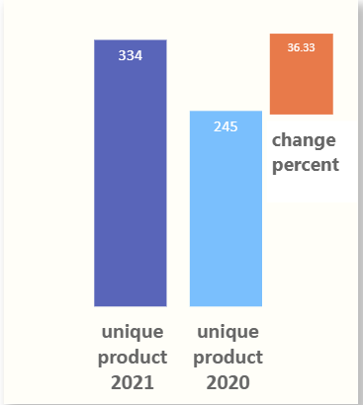

Q2. What is the percentage of unique product increase in 2021 vs. 2020? The final output contains these fields, unique_products_2020 , unique_products_2021, percentage_chg
Insight-
Number of unique Products has increased by 36.33% in 2021.

Slide 5
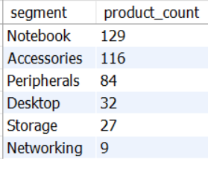
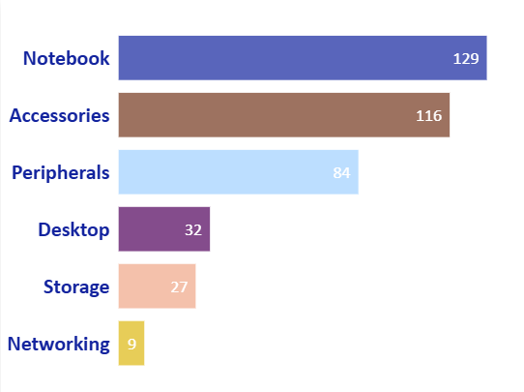
Q3. Provide a report with all the unique product counts for each segment and sort them in descending order of product counts. The final output contains 2 fields, segment, product_count
Low product
count
Insights-
Notebook, Accessories and Peripherals have high product count while Desktop, Storage and Networking have low product count.

Slide 6
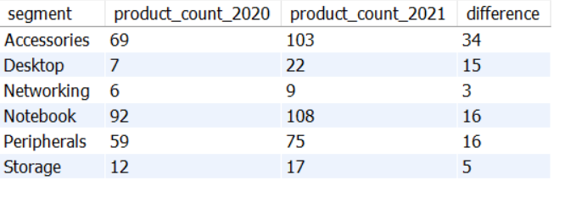
Q4. Which segment had the most increase in unique products in 2021 vs 2020? The final output contains these fields, segment product_count_2020, product_count_2021 difference.
Insights-
Accessories has the highest increase in unique products from 2020 to 2021 while networking has the lowest increase

Slide 7
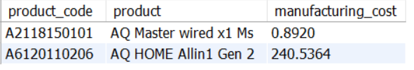
5. Get the products that have the highest and lowest manufacturing costs. The final output should contain these fields, product_code, product, manufacturing_cost
AQ HOME Allin 1 Gen 2 has the highest manufacturing cost while AQ Master wired x 1 Ms has the lowest manufacturing cost.

Slide 8
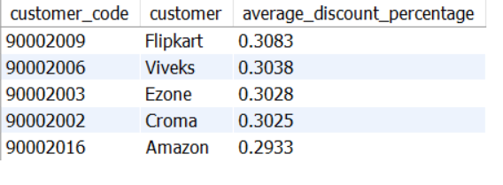
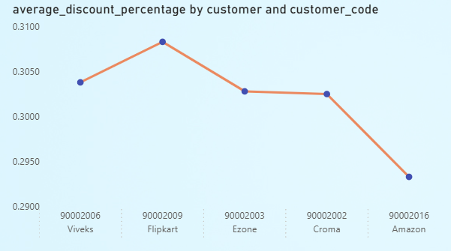
6. Generate a report which contains the top 5 customers who received an average high pre_invoice_discount_pct for the fiscal year 2021 and in the Indian market. The final output contains these fields, customer_code customer average_discount_percentage
Insight-
Flipkart gets the highest discount among customers followed by Viveks,Ezone,Croma and Amazon.
High discount means Margin erosion risk. Need for a balanced discount-profitability strategy.

Slide 9
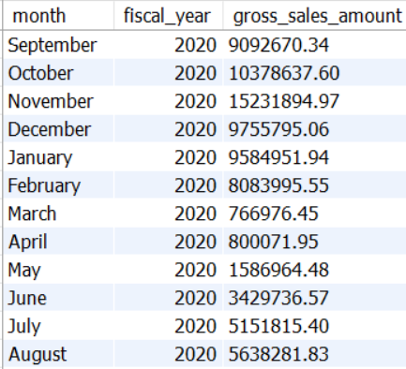
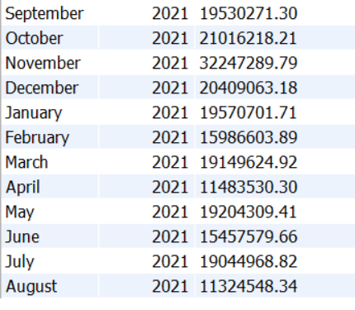
7. Get the complete report of the Gross sales amount for the customer “Atliq Exclusive” for each month . This analysis helps to get an idea of low and high-performing months and take strategic decisions. The final report contains these columns: Month Year Gross sales Amount
Fiscal year 2020
Fiscal year 2021
Note- Fiscal Year for AtliQ- September to August

Slide 10

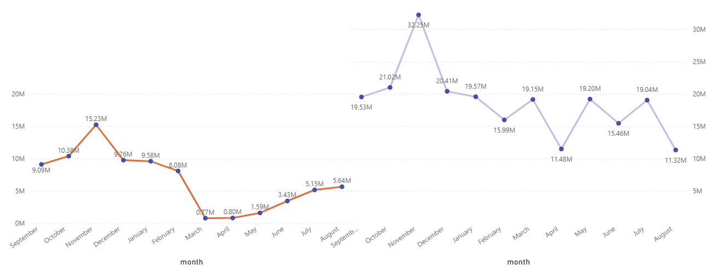

Highest Gross sales
Lowest Gross sales
FY 2020
FY 2021
Note- Fiscal Year for AtliQ- September to August
Insights-
Low gross sales are due to COVID-19 and Global Chip Shortage.

Slide 11
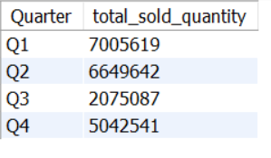
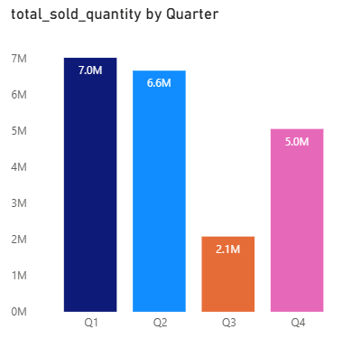
8. In which quarter of 2020, got the maximum total_sold_quantity? The final output contains these fields sorted by the total_sold_quantity, Quarter total_sold_quantity
Insight-
Q1 has the maximum total sold quantity of 7M in 2020, followed by Q2 while Q3 has the minimum total sold quantity.

Slide 12
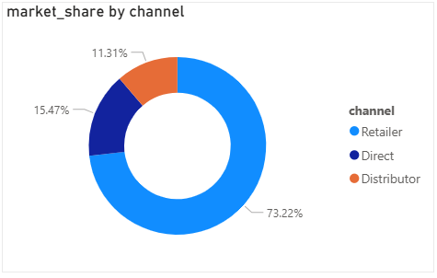
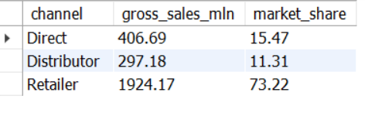
9. Which channel helped to bring more gross sales in the fiscal year 2021 and the percentage of contribution? The final output contains these fields, channel gross_sales_mln percentage
Insight-
Retailer has the highest market share followed by Direct and Distributor Channel.

Slide 13
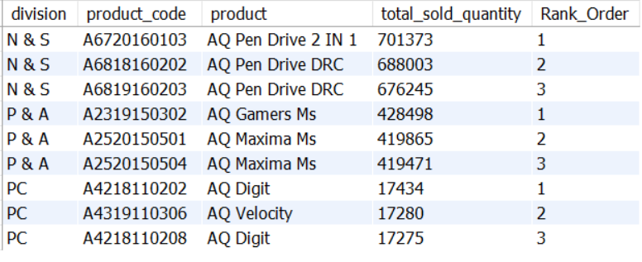
10. Get the Top 3 products in each division that have a high total_sold_quantity in the fiscal_year 2021? The final output contains these fields, division product_code
Insights-
AQ Pen Drive 2 in 1 in N & S division ,AQ Gamers Ms in P & A division and AQ Digit in PC division are the top selling products in their division.

Slide 14
Thank You

